Slide 1
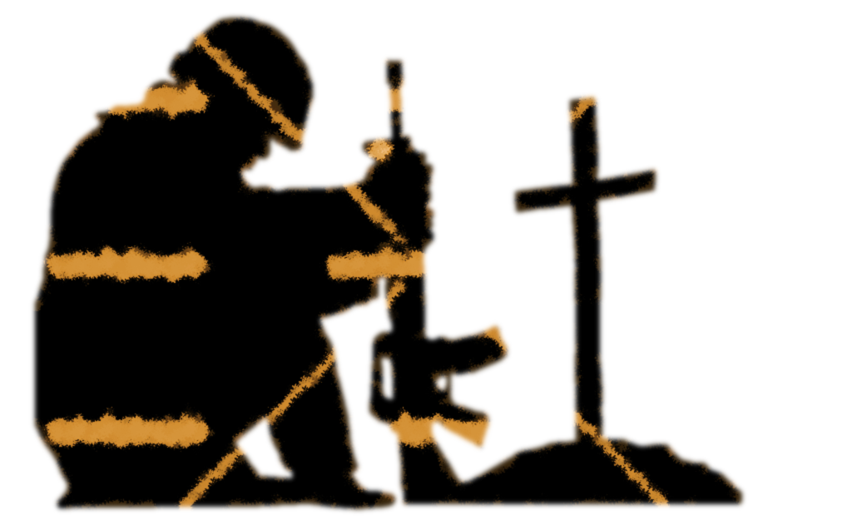
Soldier
or
Spectator
?

Slide 2
The Soldier’s Covenant
Having accepted Jesus Christ as my Saviour and Lord, and desiring to fulfil my membership of His Church on earth as a soldier of The Salvation Army, I now by God's grace enter into a sacred covenant.
I believe and will live by the truths of the word of God expressed in The Salvation Army's eleven articles of faith …
I will be responsive to the Holy Spirit's work and obedient to His leading in my life, growing in grace through worship, prayer, service and the reading of the Bible. I will make the values of the Kingdom of God and not the values of the world the standard for my life.
I will uphold Christian integrity in every area of my life, allowing nothing in thought, word or deed that is unworthy, unclean, untrue, profane, dishonest or immoral.

Slide 3
The Soldier’s Covenant (continued)
I will maintain Christian ideals in all my relationships with others; my family and neighbours, my colleagues and fellow salvationists, those to whom and for whom I am responsible, and the wider community.
I will uphold the sanctity of marriage and of family life. I will be a faithful steward of my time and gifts, my money and possessions, my body, my mind and my spirit, knowing that I am accountable to God.
I will abstain from alcoholic drink, tobacco, the non-medical use of addictive drugs, gambling, pornography, the occult and all else that could enslave the body or spirit.
I will be faithful to the purposes for which God raised up The Salvation Army, sharing the good news of Jesus Christ, endeavouring to win others to Him, and in His name caring for the needy and the disadvantaged.

Slide 4
The Soldier’s Covenant (continued)
I will be actively involved, as I am able, in the life, work, worship and witness of the corps, giving as large a proportion of my income as possible to support its ministries and the worldwide work of the Army.
I will be true to the principles and practices of The Salvation Army, loyal to its leaders, and I will show the spirit of salvationism whether in times of popularity or persecution.
I now call upon all present to witness that I enter into this covenant and sign these articles of war of my own free will, convinced that the love of Christ, who died and now lives to save me, requires from me this devotion of my life to His service for the salvation of the whole world; and therefore do here declare my full determination, by God's help, to be a true soldier of The Salvation Army.

Slide 5
The Salvation Army concept of soldiership
Builds on the Biblical concept of spiritual soldiers
A Salvation Army soldier is someone who:
Signs the Soldier’s Covenant
First and foremost is a committed disciple of Jesus
Much more than becoming ‘a member’
Covenant covers almost every aspect of life
Radical commitment to following Jesus
‘Having accepted Jesus Christ as my Saviour and Lord, and desiring to fulfil my membership of His Church on earth as a soldier of The Salvation Army, I now by God's grace enter into a sacred covenant.’ (Soldier’s Covenant)

Slide 6
1. Acknowledge there is a war
‘Put on the full armour of God, so that you can take your stand against the devil’s schemes. ¹² For our struggle is not against flesh and blood, but against the rulers, against the authorities, against the powers of this dark world and against the spiritual forces of evil in the heavenly realms.’ (Ephesians 6:11-12)
‘Be alert and of sober mind. Your enemy the devil prowls around like a roaring lion looking for someone to devour.’ (1 Peter 5:8)
We aren’t spectators. This isn’t a cute, metaphorical war—it’s the real thing. We are called to help, to enlist, to fight. This is the call of true discipleship and our great heritage of Salvationism.’ (Major Danielle Strickland)

Slide 7
2. Train for Battle
If you know you’re going into a dangerous fight, you will prepare for it
The Soldier’s Covenant starts with building blocks essential to the spiritual battle
The Christian soldier recognises that their power source is God.
I will be responsive to the Holy Spirit's work and obedient to His leading in my life, growing in grace through worship, prayer, service and the reading of the Bible. (Soldier’s Covenant)

Slide 8
3. Throw off anything that hinders
‘Let us throw off everything that hinders and the sin that so easily entangles’ (Hebrews 12:1)
‘No one serving as a soldier gets entangled in civilian affairs.’ (2 Timothy 2:4a)
‘³ But among you there must not be even a hint of sexual immorality, or of any kind of impurity, or of greed, because these are improper for God’s holy people. ⁴ Nor should there be obscenity, foolish talk or coarse joking, which are out of place, but rather thanksgiving. ⁵ For of this you can be sure: No immoral, impure or greedy person–such a man is an idolater–has any inheritance in the kingdom of Christ and of God.’ Ephesians 5:3-5
I will uphold Christian integrity in every area of my life, allowing nothing in thought, word or deed that is unworthy, unclean, untrue, profane, dishonest or immoral. (Soldier’s Covenant)

Slide 9
3. Throw off anything that hinders (continued)
A Christian soldier is an ambassador for God, living by different standards, that flow into every area of our lives
I will maintain Christian ideals in all my relationships with others; my family and neighbours, my colleagues and fellow salvationists, those to whom and for whom I am responsible, and the wider community.
I will uphold the sanctity of marriage and of family life. I will be a faithful steward of my time and gifts, my money and possessions, my body, my mind and my spirit, knowing that I am accountable to God.

Slide 10
3. Throw off anything that hinders (continued)
A range of surveys all claim that 50% of the Christian men surveyed view pornography regularly (e.g. PromiseKeepers, Focus on the Family, Christianity Today)
Not just a problem for men – other surveys reveal one in three visitors to adult websites are women
I will abstain from alcoholic drink, tobacco, the non-medical use of addictive drugs, gambling, pornography, the occult and all else that could enslave the body or spirit. (Soldier’s Covenant)

Slide 11
4. Engage in the Fight
How many non-Christian friends do you spend time with intentionally
I will be faithful to the purposes for which God raised up The Salvation Army, sharing the good news of Jesus Christ, endeavouring to win others to Him, and in His name caring for the needy and the disadvantaged.
I will be actively involved, as I am able, in the life, work, worship and witness of the corps, giving as large a proportion of my income as possible to support its ministries and the worldwide work of the Army.
I will be true to the principles and practices of The Salvation Army, loyal to its leaders, and I will show the spirit of salvationism whether in times of popularity or persecution. (Soldier’s Covenant)
How involved are you in our church? Do you support us financially?
How loyal are we to each other and to our divisional and territorial leaders?

Slide 12
Summary
Acknowledge there is a spiritual war
Train for the battle
Throw off anything that hinders
Engage in the fight
Knowing they can’t fight on their own, the Christian soldier plugs into God’s power and relies on Him as they serve in the battle.
A spectator doesn’t need God’s power.
Which are you?

Slide 14
The promise
I now call upon all present to witness that I enter into this covenant and sign these articles of war of my own free will, convinced that the love of Christ, who died and now lives to save me, requires from me this devotion of my life to His service for the salvation of the whole world; and therefore do here declare my full determination, by God's help, to be a true soldier of The Salvation Army. (Soldier’s Covenant)

Slide 15
Soldier
or
Spectator
?

